Slide 1
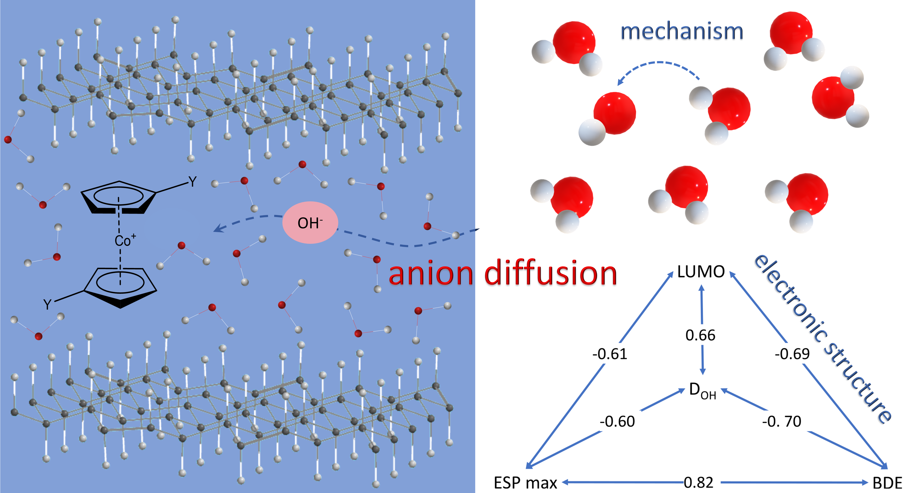

Theoretical Examination of the Hydroxide Transport in Cobaltocenium-Containing Polyelectrolytes
Sachith Wickramasinghe
Department of Chemistry and Biochemistry
University of South Carolina
November 22nd, 2023

Slide 2

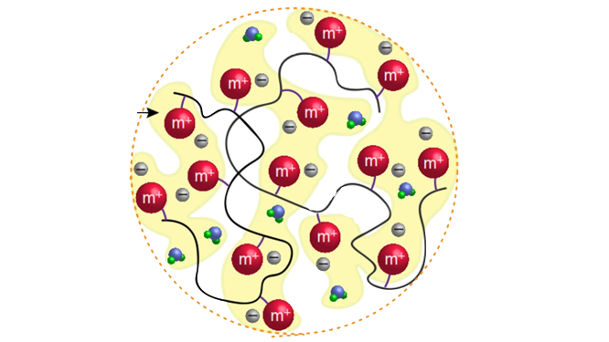
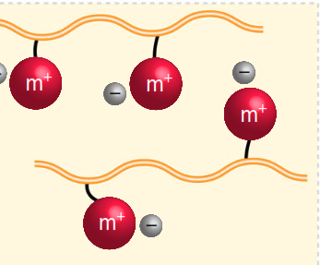
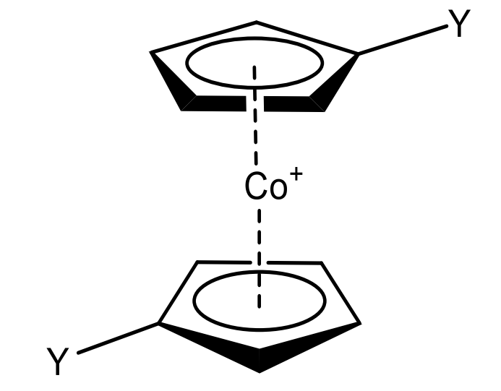
Metallo-Polyelectrolytes For hydroxyl Ion Transport
Focus on hydroxyl transport
Enhance the ionic conductivity
Examine the mechanisms and the pathways
Vehicular and structural diffusion
NQE
Hydration level
Substituent on the cation

Slide 3
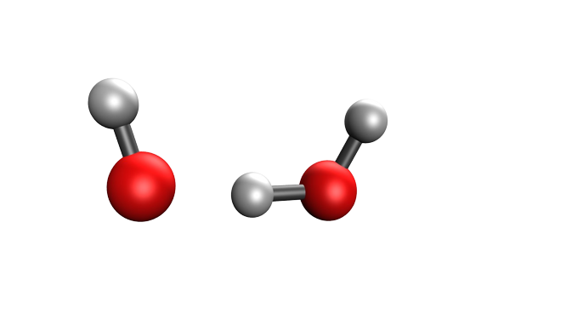
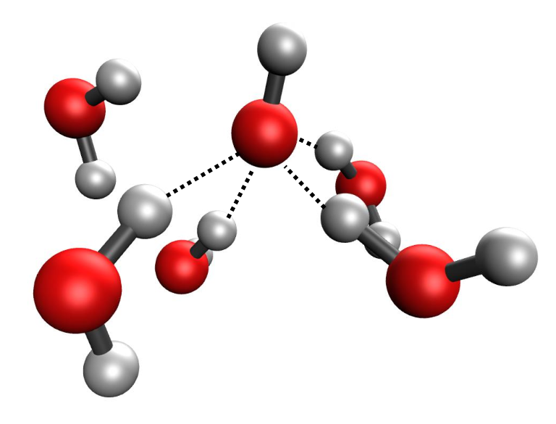
Mechanisms of Diffusion
Vehicular diffusion
Hopping
Hydroxide vs proton hopping
Tuckerman, Mark E., Dominik Marx, and Michele Parrinello. "The nature and transport mechanism of hydrated hydroxide ions in aqueous solution. " Nature 417.6892 (2002): 925-929.

Slide 4
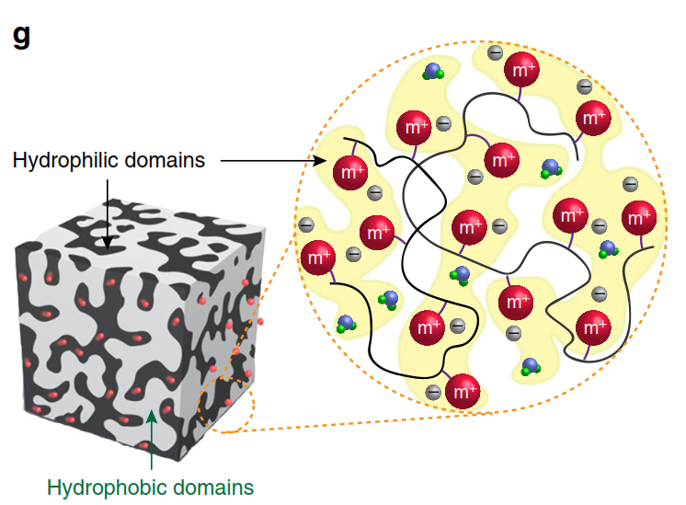
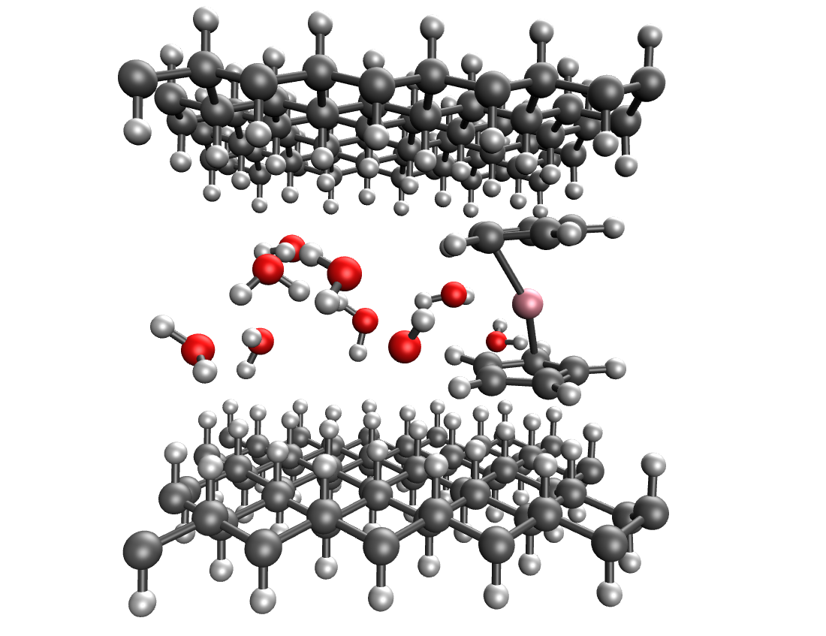


Modeling
Molecular model
System
graphane sheets
mimic polymeric back bone
Molecular Dynamics (MD)
DFTB
cobaltocenium cation
hydroxide
water
4
Notes:
phase-separated morphology
We performed on-the-fly Molecular Dynamics (MD) simulations at the DFTB level of theory with periodic boundary conditions.

Slide 5
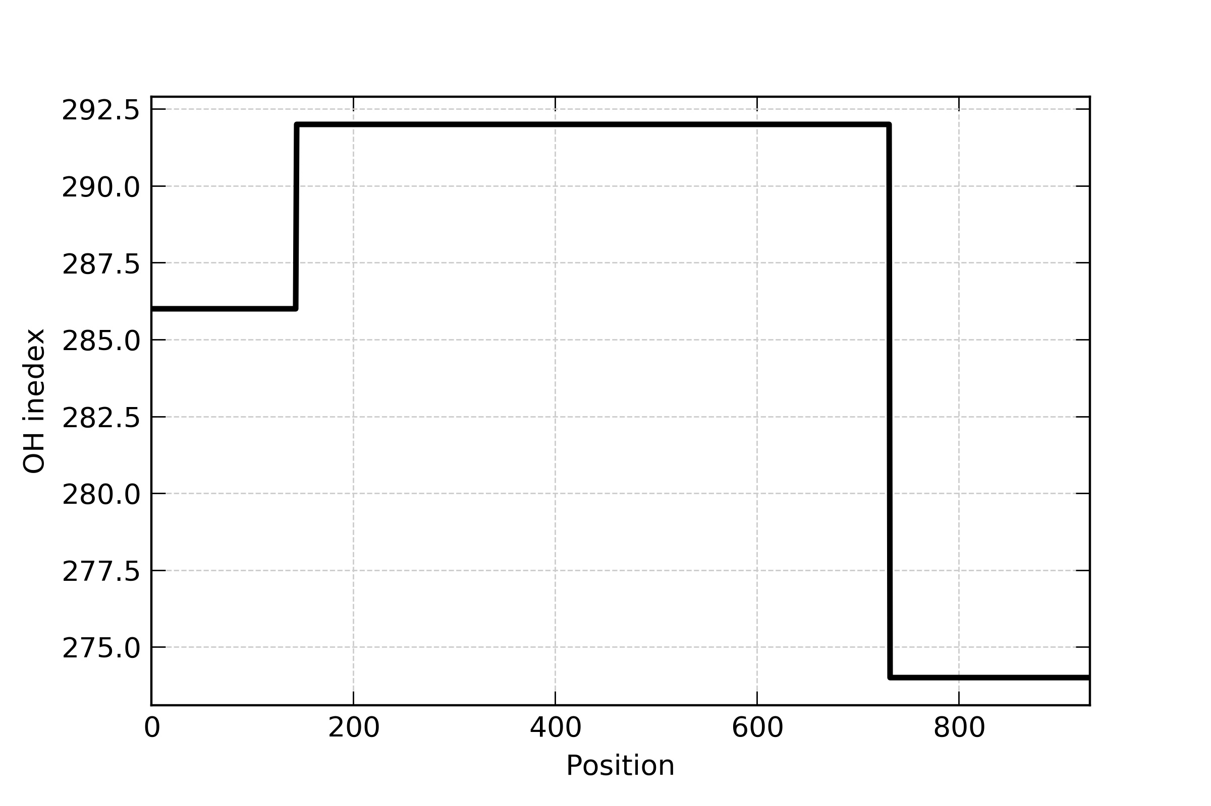
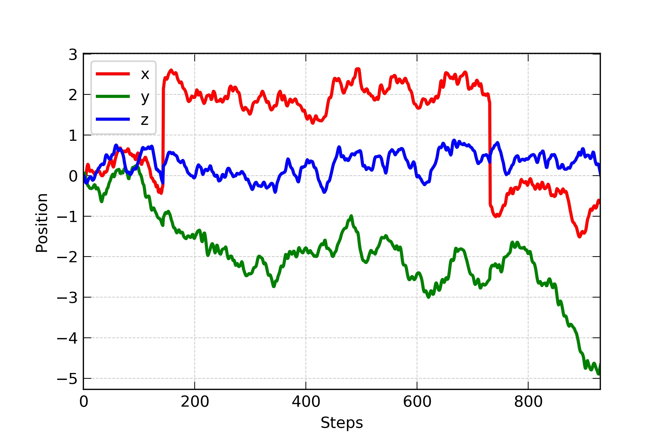
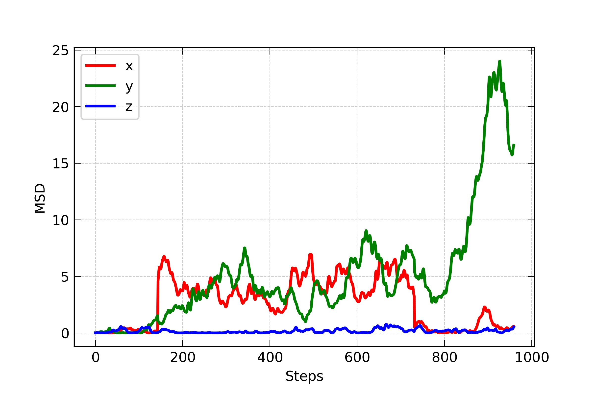
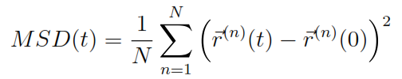
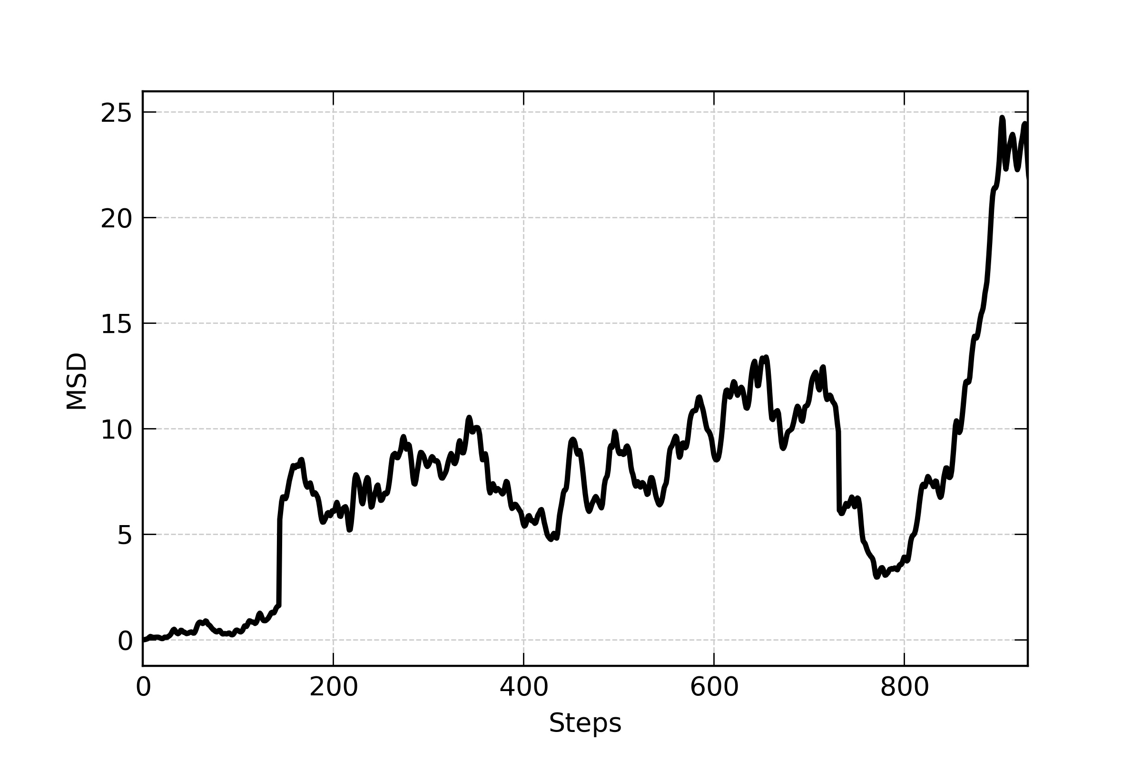
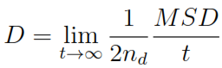
Estimation of Diffusion Coefficient
10-40 water molecules
Xbox = 12.66 Å dt = 1fs
Ybox = 13.36 Å 20 ps
Hydroxide moves between cobaltocenium groups
Multiple hops occur
Rattling is removed from the analysis
Long trajectory is needed

Slide 6
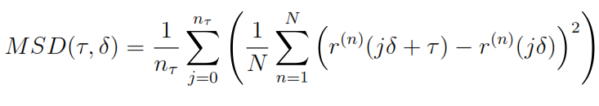
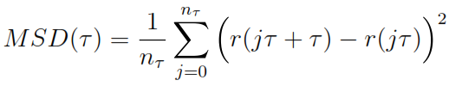
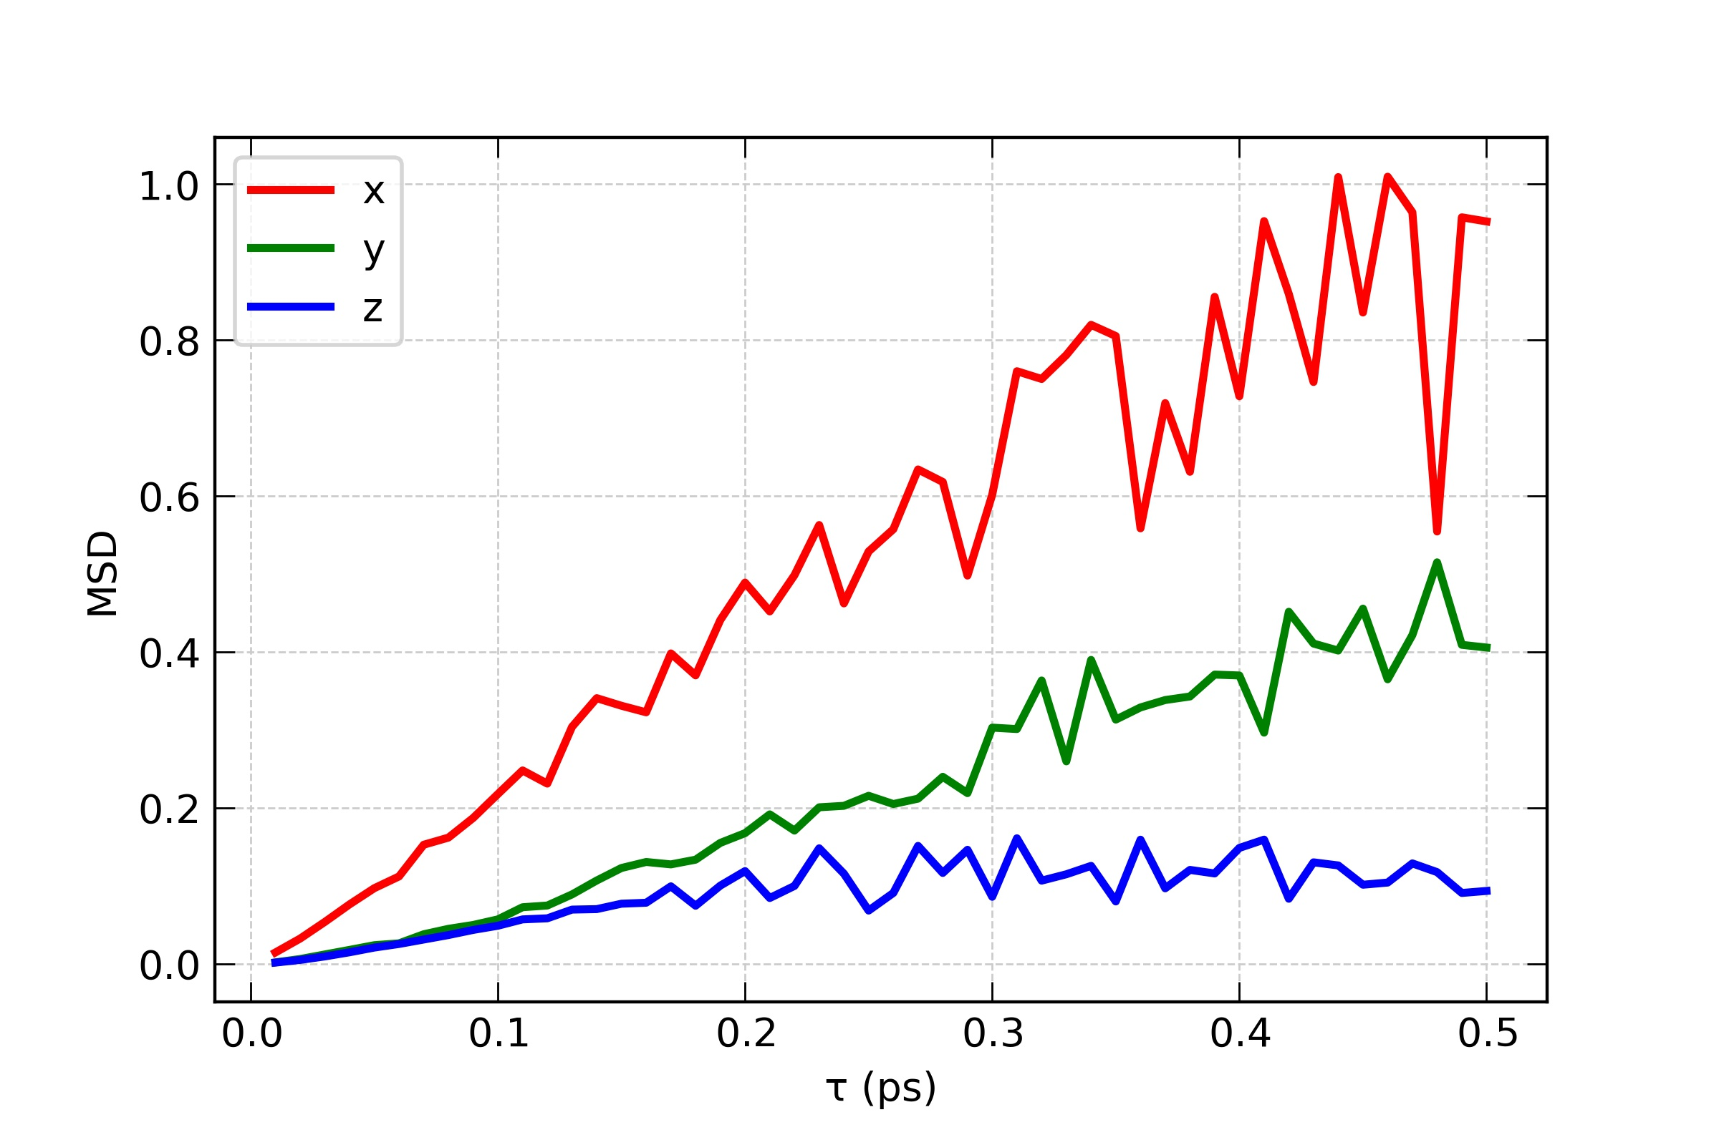
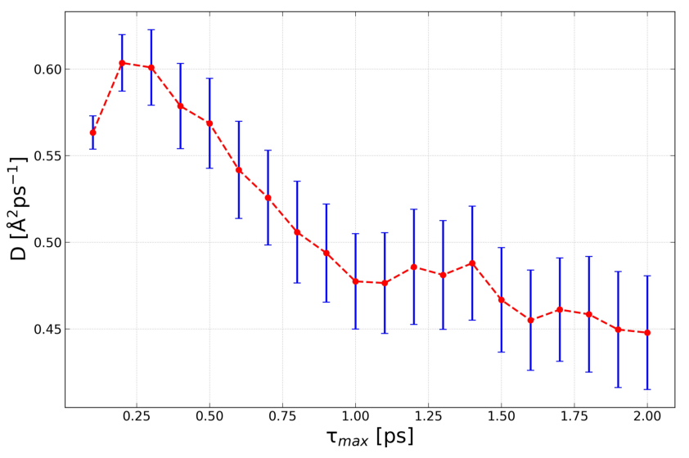
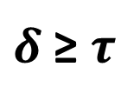
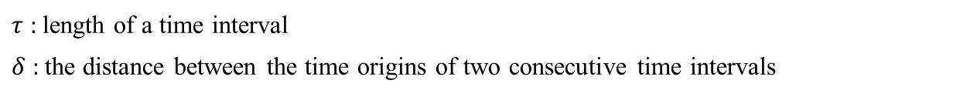
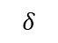
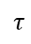
Estimation of Diffusion Coefficient
Time-averaged method of calculating D
$$τ$$
$$δ$$
$τ$ : length of a time interval
$δ$ : the distance between the time origins of two consecutive time intervals
$δ$ ≥ $τ$
Pranami, G.; Lamm, M. H. Estimating error in diffusion coefficients derived from molecular dynamics simulations. J. Chem. Theory Comput. 2015,11, 4586–4592.

Slide 7
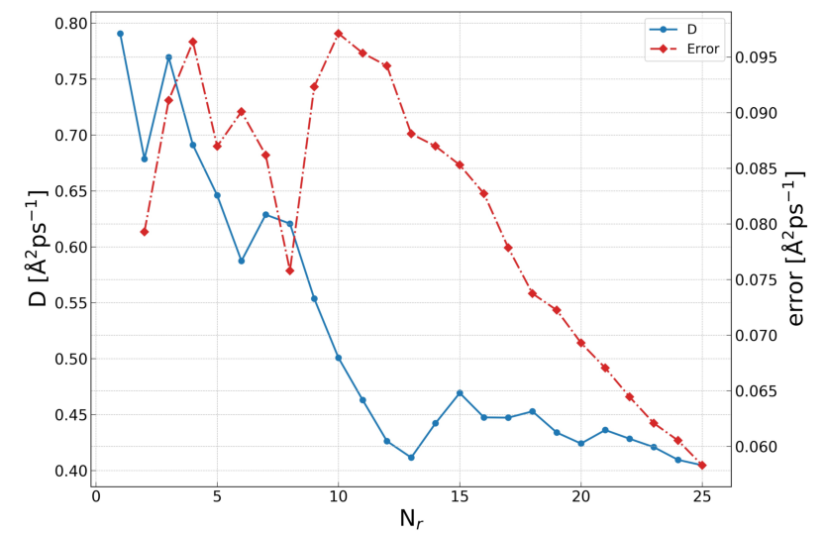
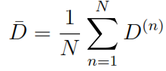
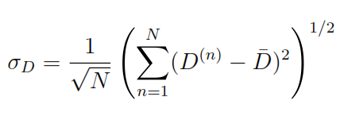
Use of Replicas
MSD of single molecule is noisy
Use Replicas
Same cell geometry
Same cation separation
Same number of water
Different initial position of water and OH⁻
Different initial velocities for thermalization
Run trajectories in parallel

Slide 8
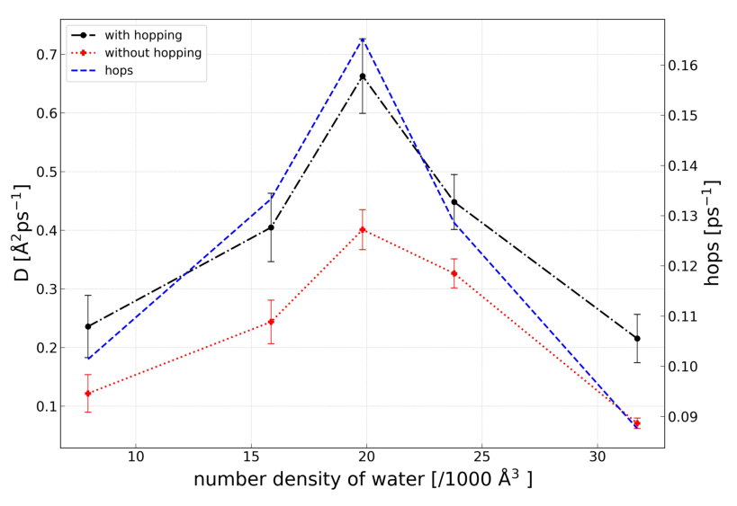
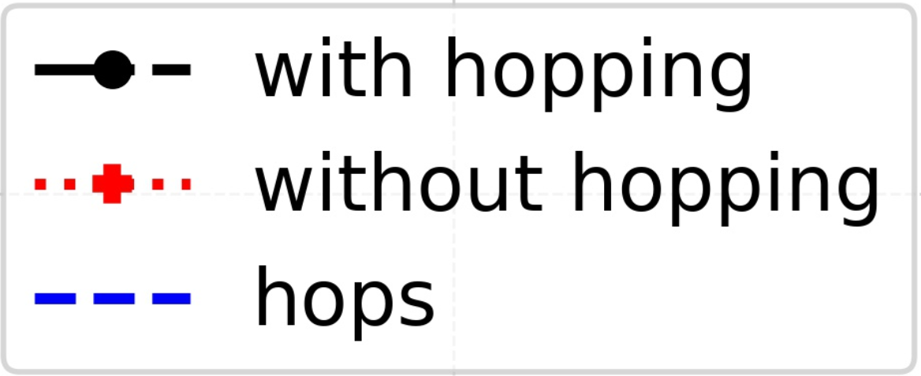
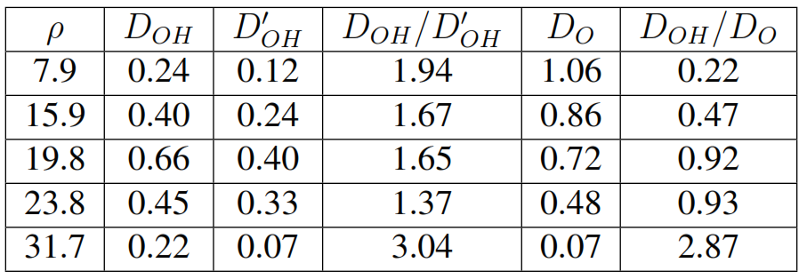
Diffusion Coefficient at Different Hydration Levels
D_{OH} changes significantly with water density
Lowest and highest densities exhibit low D_{OH}
Maximum D_{OH} (~0.7Å²/ps) at ~60% of bulk
D_{OH} correlates with the number of hops
Low densities: electrostatic interaction
Hopping incurrences D_{OH} by ~2
Wickramasinghe, Sachith, et al. "Theoretical Examination of the Hydroxide Transport in Cobaltocenium-Containing Polyelectrolytes." J. Phys. Chem. B (2023).
Notes:
Hoping contributions to the D is more significant at higher and law water densities

Slide 9
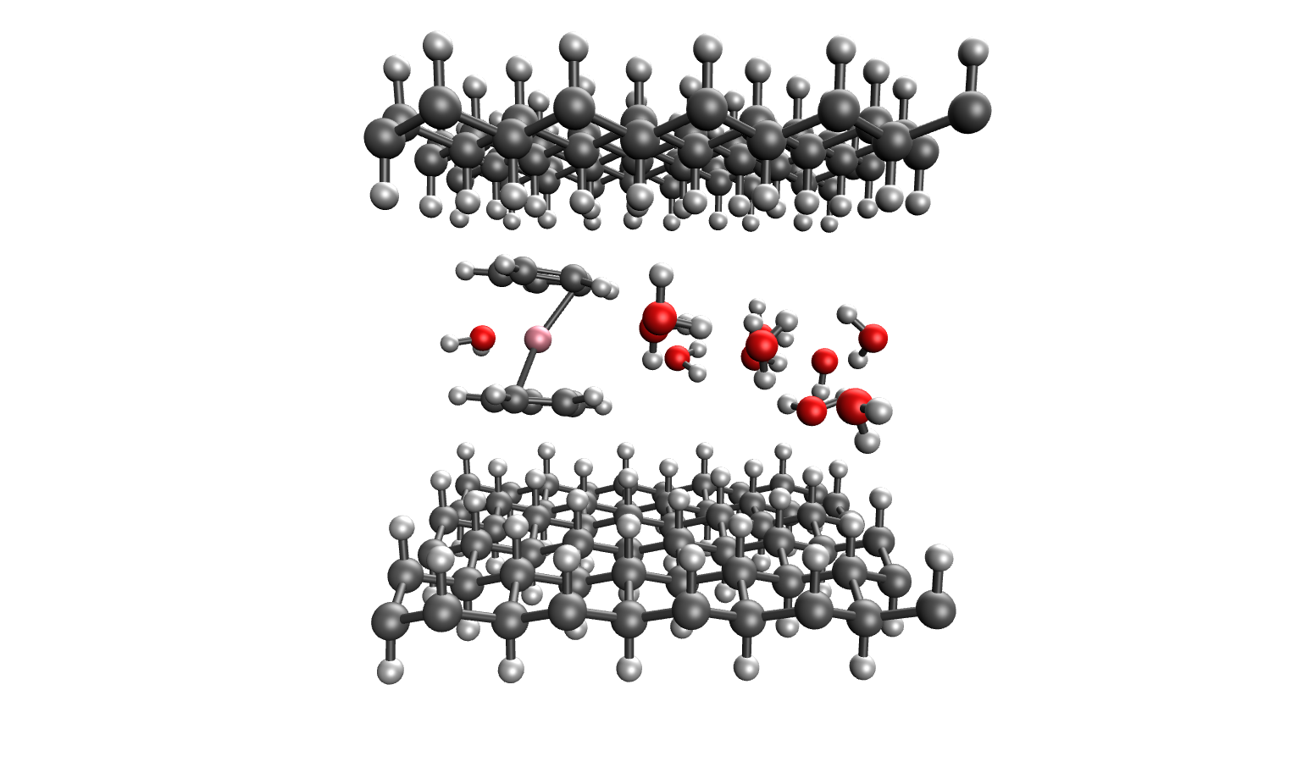
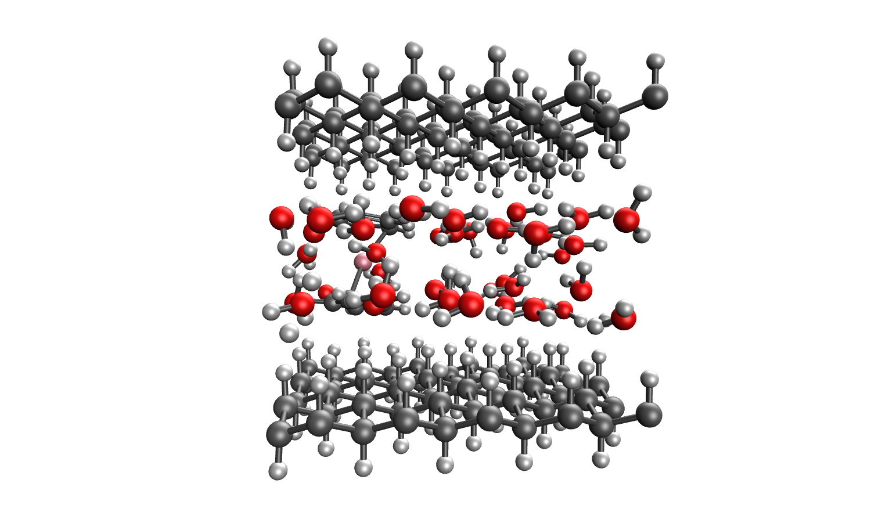
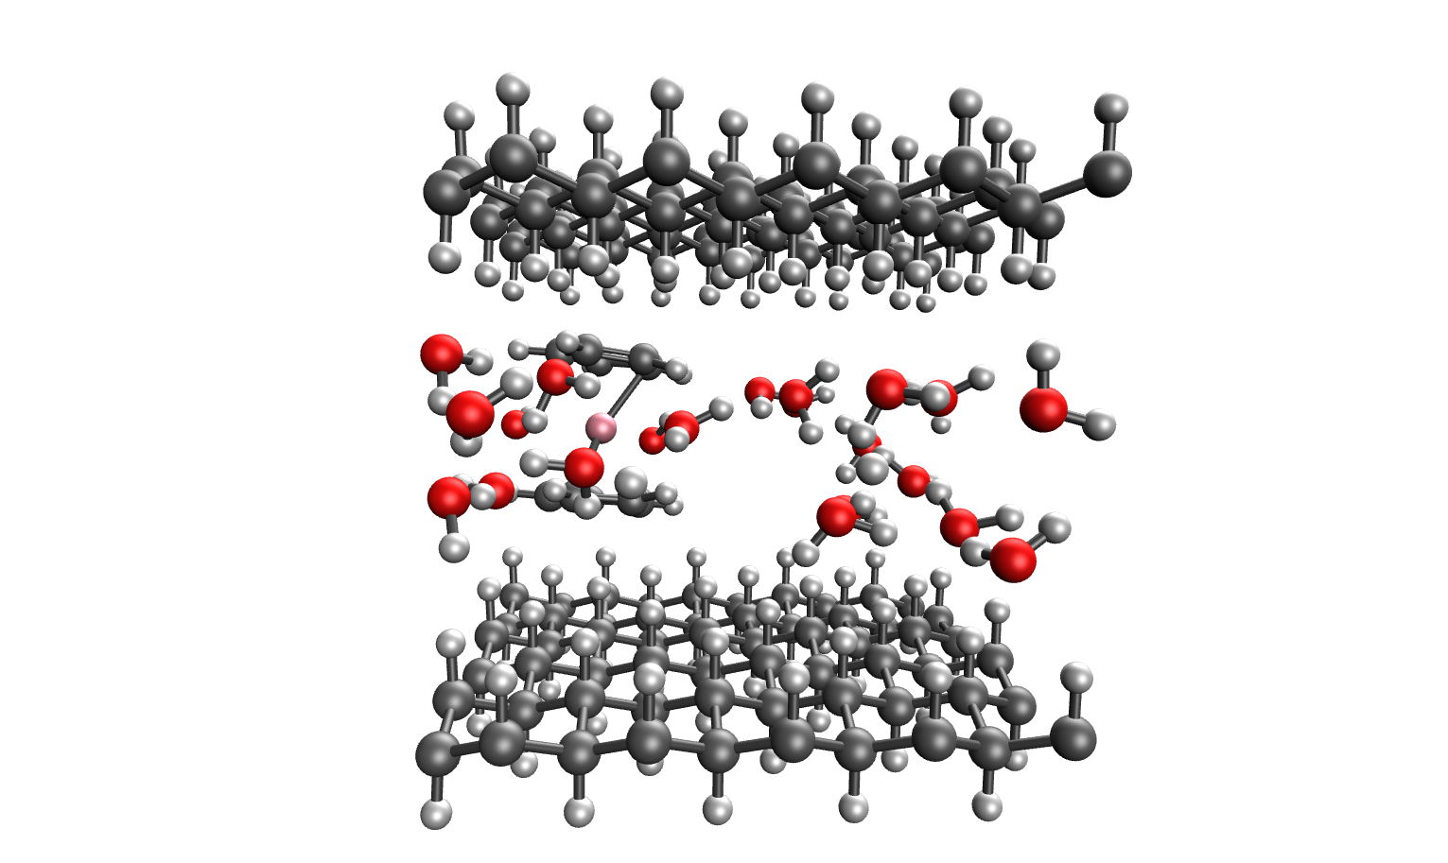
Diffusion Coefficient with Different Hydration Levels
Low water density
High water density
Water molecules are nearly free
Hydroxide lacks a well-formed solvation shell, thus low diffusion
Water molecules form two layers
Domain size and mobility are reduced
Diffusion rates decrease due to increased confinement
Medium water density
Hydroxide is well solvated
Less coulombic attraction
Highest hopping rate
Wickramasinghe, Sachith, et al. "Theoretical Examination of the Hydroxide Transport in Cobaltocenium-Containing Polyelectrolytes." J. Phys. Chem. B (2023).

Slide 10
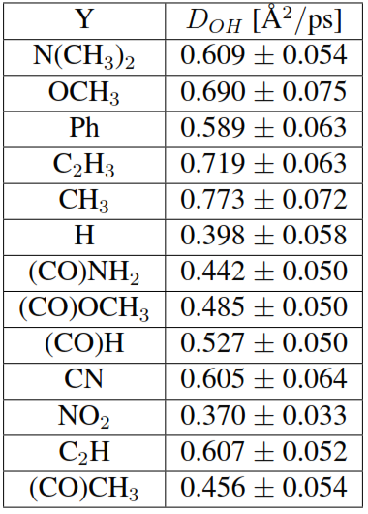
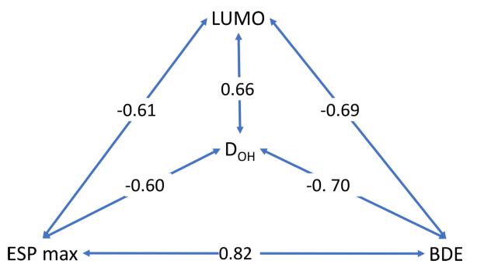
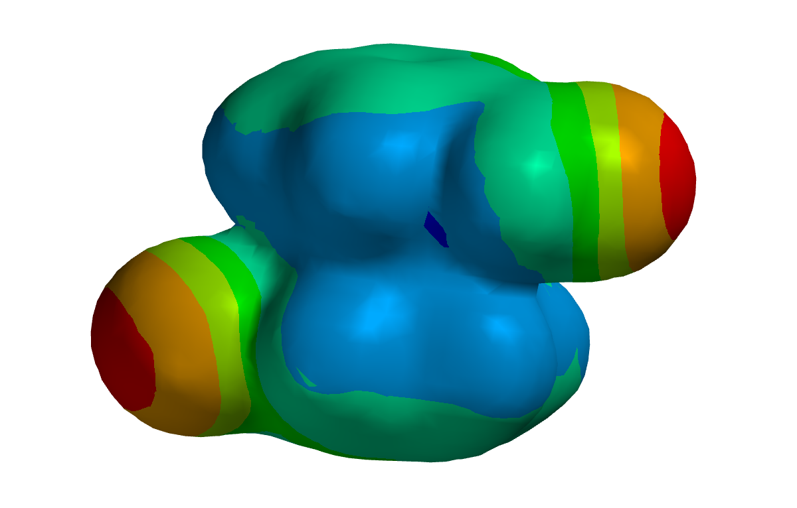
Substituent Iffect on Hydroxide Diffusion
D_{OH} highly correlates with ESP max, cation LUMO, and BDE
No correlation with dipole moment
Positive ESP max indicates strong surface charges attracting hydroxyl ions
Lower LUMO attracts the hydroxide electrons
High BDE values indicate stronger hydroxide binding to cation, reducing mobility
BDE = (E_{cation} + E_{hydroxide}) - E_{complex}
Modifying the cation can enhance anion mobility
Wickramasinghe, Sachith, et al. "Theoretical Examination of the Hydroxide Transport in Cobaltocenium-Containing Polyelectrolytes." J. Phys. Chem. B (2023).

Slide 11
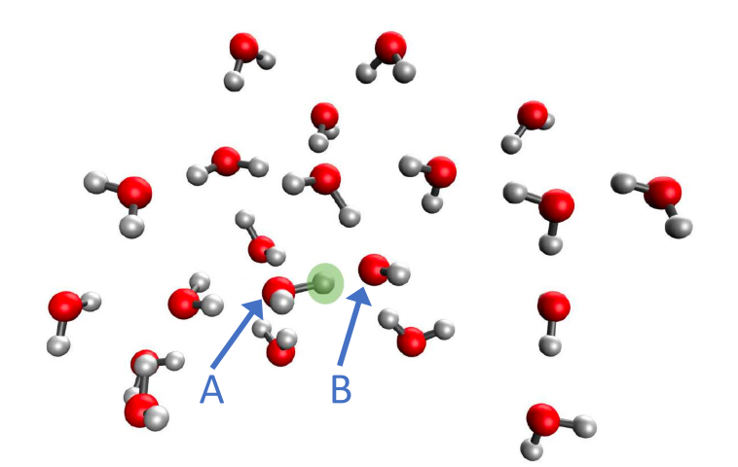
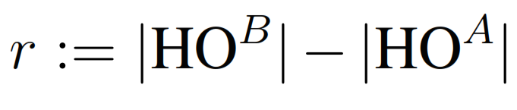
Nuclear Quantum Effects on Proton Hopping
Hopping is affected by nuclear quantum effects (NQEs)
Time-dependent PES is constructed using 13 snapshots
PES is obtained from the partial energy minimization with respect to the positions of the hydrogen atoms attached to the donor and acceptor oxygens

Slide 12
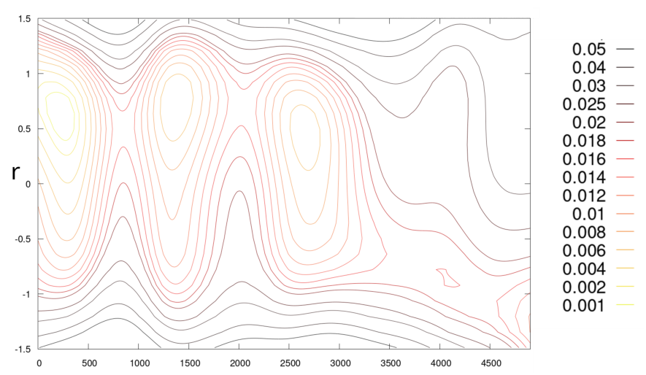
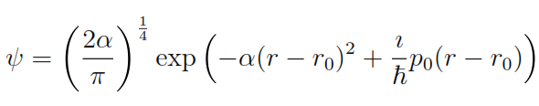


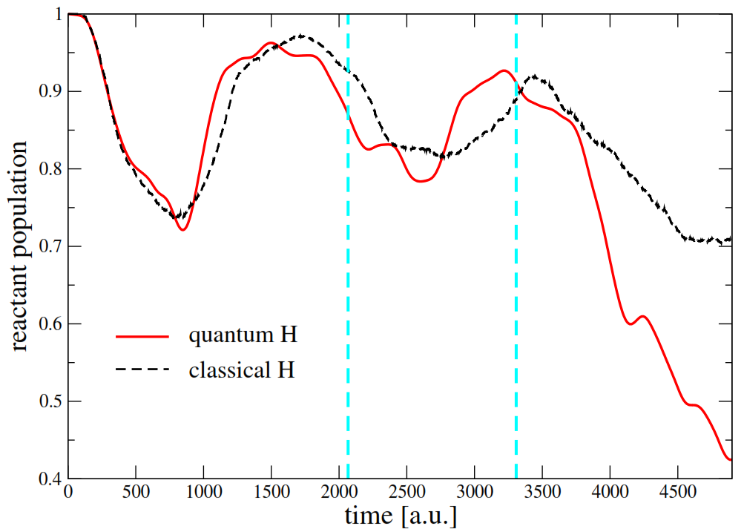

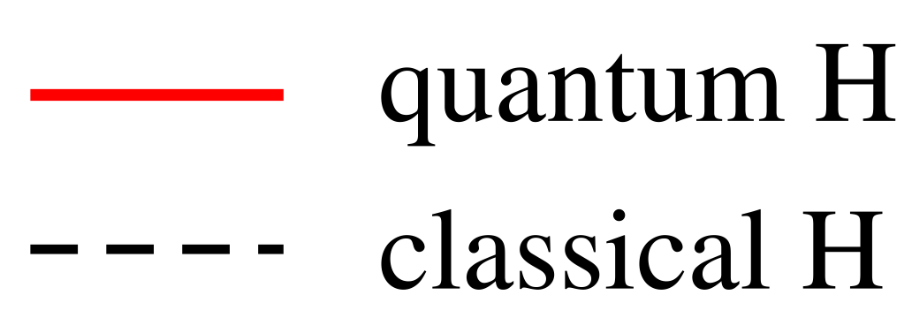
Nuclear Quantum Effects on Proton Hopping
Reactant
: harmonic approximation at the initial position
: translational energy corresponds to 300 K
Product
2000 classical trajectories sampled from the Wigner distribution
60% of the quantum proton wavefunction enters potential energy well
30% of the classical trajectories
Notes:
The initial oscillatory behavior of the reactant probability correlates with disappearing and reappearing of the PES reactant well induced by environment

Slide 13

Summary
Both vehicular and structural diffusion mechanisms are important.
Hopping can incurrences D_{OH} by ~2
The highest diffusion coefficients (~0.7 Å²/ps) is at moderate hydration levels (~60% liquid water density).
Sufficient water molecules and space for proton hopping.
Hydroxide diffusion correlates with electrostatic potential maximum, complex dissociation energy, and energy of the cation LUMO.
Chemical modification of the cation can enhance anion mobility
The NQE increases hopping probability by ~ 2 compared to the classical probability.

Slide 14


Acknowledgement
Special thanks to:
Prof. Sophya Garashchuk
Prof. Vitaly Rassolov
Collaborators:
Prof. Chuanbing Tang
Prof. Qi Wang
Dr. Jacek Jakowski
Dr. Shehani Weththasinghe
Alexandria Hoehn
Funding:

Slide 15

Thank you!

